Slide 1

University of Toronto Data Visualization Boot Camp – Project Football
Mauricio Avila, Gurpreet Chug,
Jeremy Mallory, Doran Rainford
Gavin Toole, Anthony Verma

Slide 2





Question of Interest and Motivation
Do fans affect a teams winning percentage?
What statistic best predicts team success?
Which league is them most competitive?
The 5 major European Leagues were analyzed:
EPL – English Premier League
Serie A – Italian League
La Liga – Spanish League
Bundasliga = German League
La Ligue – France League

Slide 3
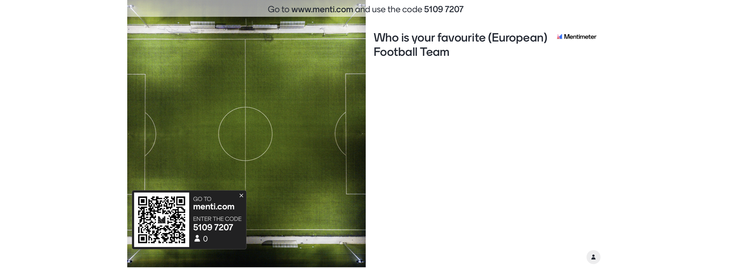
Class Polls

Slide 4
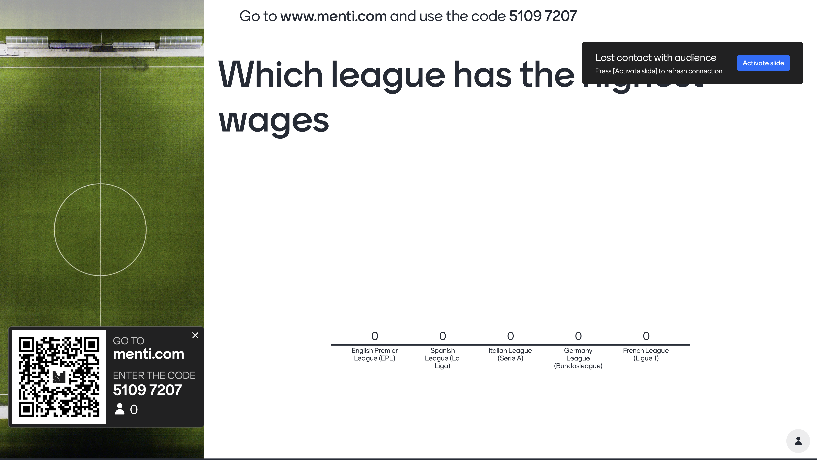

Class Polls

Slide 5
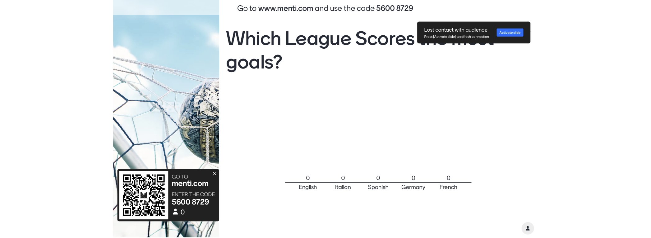
Class Polls

Slide 6
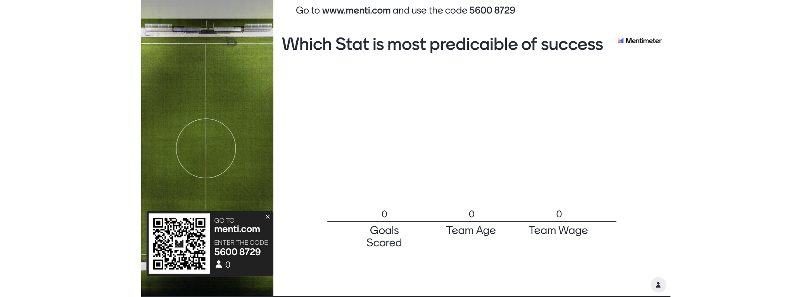
Class Polls

Slide 7
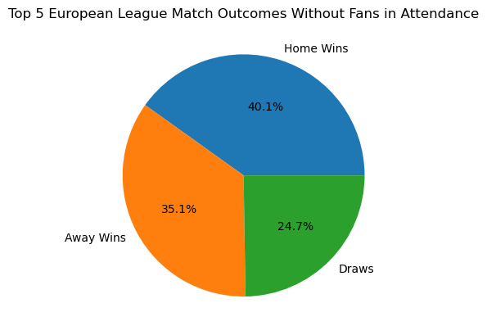
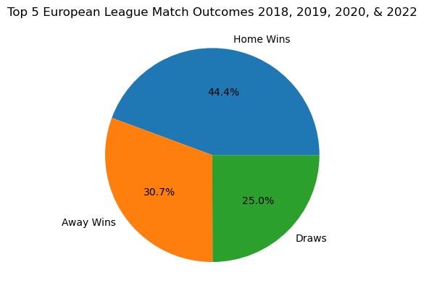
Conclusions and Summary - Attendance
With the COVID Season and no fans allowed in the stadium we investigated if fans helped the home team win
Notes:
When fans were in the stands the home time won 4.3% more than without fas

Slide 8
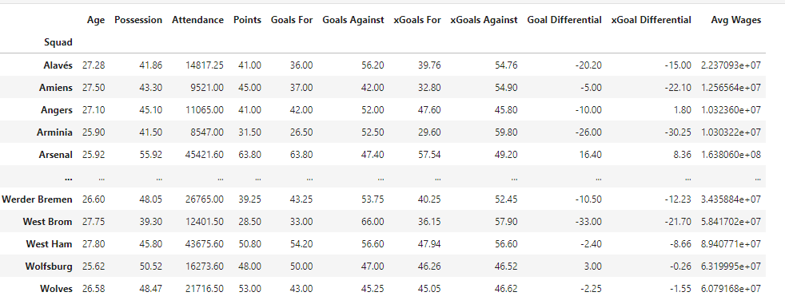
Analysis Process
Data was retrieved from: https://fbref.com/en
5 seasons of data were retrieved, cleaned and analyzed for each league and then combined to 2 DateFrames:
Team Summary Match Summary

Slide 9
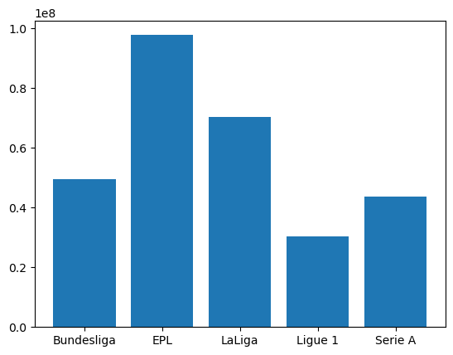
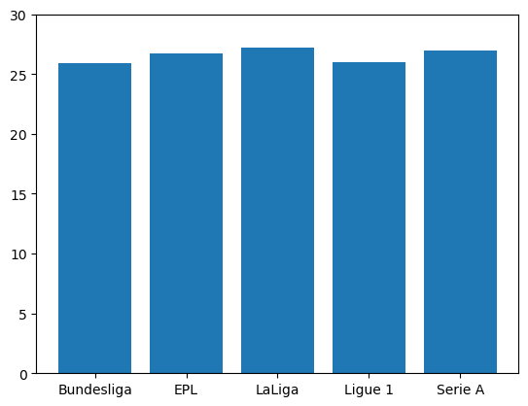
Conclusions and Summary – Team Stats Wages and Average Age
Notes:
When fans were in the stands the home time won 4.3% more than without fans

Slide 10
Conclusions and Summary – Match Results
Possession
Annual Wage
Notes:
When fans were in the stands the home time won 4.3% more than without fans

Slide 11
Conclusions and Summary – Match Results
Annual Wage
Attendance
Notes:
When fans were in the stands the home time won 4.3% more than without fans

Slide 12
Conclusions and Summary – Match Results
Goals Scored Actual and Expected
Notes:
When fans were in the stands the home time won 4.3% more than without fans

Slide 13
Conclusions and Summary – Match Results
Goals Conceded Actual and Expected
Notes:
When fans were in the stands the home time won 4.3% more than without fans

Slide 14
Implications

